Slide 1
Match! There is an extra letter on purpose!
What’s up?
How are you?(formal)
Good morning
Hi/ bye (peace)
See you later
See you tomorrow
Goodbye
Good night
See you when I see you
Hasta mañana:
Hasta luego:
Buenas Noches:
Buenos días:
Chau:
¿Cómo está?:
¿Qué tal?:
Adiós :

Slide 2
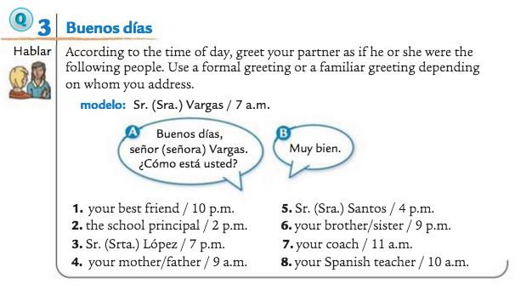
Greeting/Salutation Warm up: WRITE ANSWERS ON THE NEXT SLIDE

Slide 3
1.
2.
3.
4.
5.
6.
7.
8.

Slide 4
Say “good morning” to your teacher in your first period class.
Say “good afternoon” to your teacher after lunch
Tell your friend you will see him tomorrow.
Tell you friend that you will see her later
Say good night to your parents.

Slide 5
Telephone numbers:
Write the Spanish word for the number below the numbers!
8 | 3 | 2 | 5 | 1
7 | 9 | 10 | 4 | 6

Slide 6
Given the letters, decode the secret message
I griega, O, U
Hache, a, uve, e
Te, o
Ese, te, u, de, i griega
Efe, o, ere
Te, hache, e
Cu, u, i, zeta
Te, o, eme, o, erre, o, doble uve

Slide 7
What the quiz will look like..
Greetings/ salutations: matching
Numbers: I’ll give you the Spanish word, you write out the number
ABC’s: I give you the letters and you decode the message

