Slide 1
Gustar practice
Share with Señor Dean to recieve credit

Slide 2
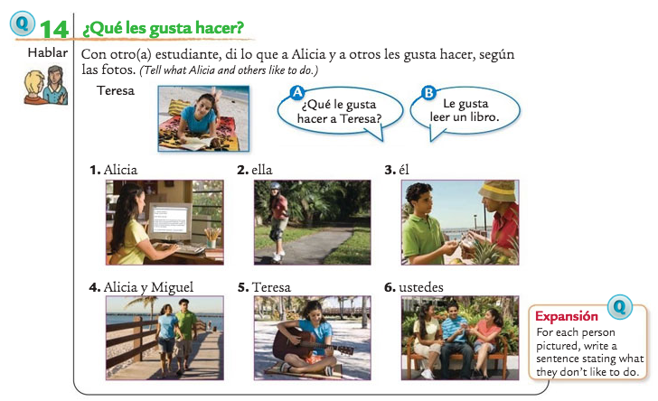

Slide 3
Write sentences based on the pictures
1.
2.
3.
4.
5.
6.

Slide 4
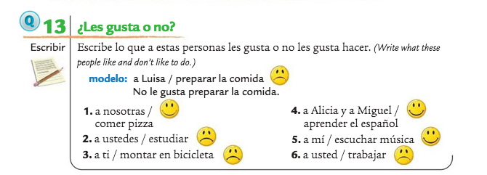

Slide 5
Write what they do or do not like in a full sentence.
1.
2.
3.
4.
5.
6.

Slide 6
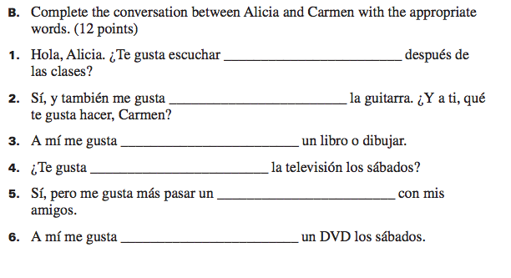

Slide 7
Fill in the missing vocab word
1.
2.
3.
4.
5.

Slide 8
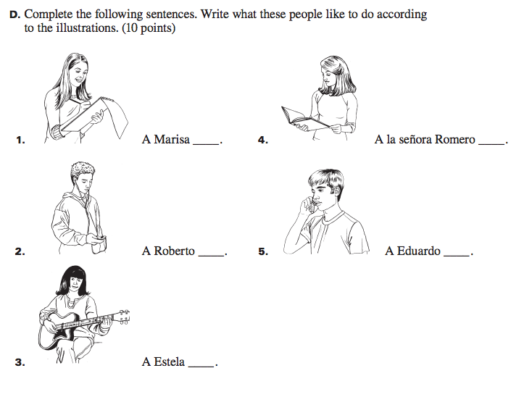

Slide 9
Write sentences describing what they like to do!

Slide 10
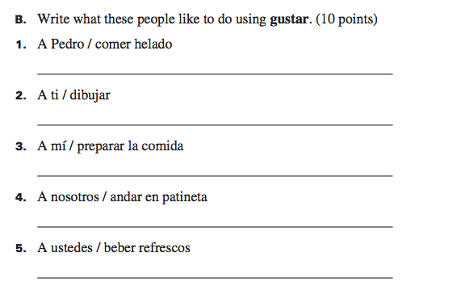

Slide 11
Write sentences filling in the gustar form.
1.
2.
3.
4.
5

